Slide 1
Digital Id Verified Contact Program

Slide 2
The Problem:
A Migrant Worker who arrives at a new locality may not have all the necessary skills or training to understand what are their entitlements. The worker may not be aware of all the requirements to practice a particular trade in the locality. A contact program for such migrant worker can help bring upskill.
Carrying documents along with them to prove that they are skilled to all job sites may not be a practical solution.
Solution
A Skill verification Network (Skill Net) on Blockchain can serve as a Skill Attestation Network to prove that the workers are experienced in specific Trade. The Skill Attestation Network will also enable the worker to self-nominate/attend any available upskilling programs at contact centres in their area.
The migrant work can register them self or through a Trusted authority get registered on Skill Net. For every eligible contact program Skill Net will issue a unique DIFA (Digital ID For All) for the Migrant Worker using which the worker can attend and complete the upskilling program. Skill Net Application takes into account certain basic documents that can prove without divulging unnecessary personal information about the worker into the public domain.
Actors:
Migrant Workers Skill India Program Coordinators Contact Program Centres Potential Employers Roles :
Issuer: Skill Net Registry.
Verifier: Contact Centres/Skill India program coordinators.
Holder/Prover: (Worker or Trusted Authority/Assessment Centres).
Benefits:
Skill Net can keep track of Migrant worker's skills acquired through contact programs and verified at contact centres. The solution is built on top of existing India Stack and services.
Skill Net can be enhanced further to include background verification check as required, without compromising on personal details at any point in time

Slide 3
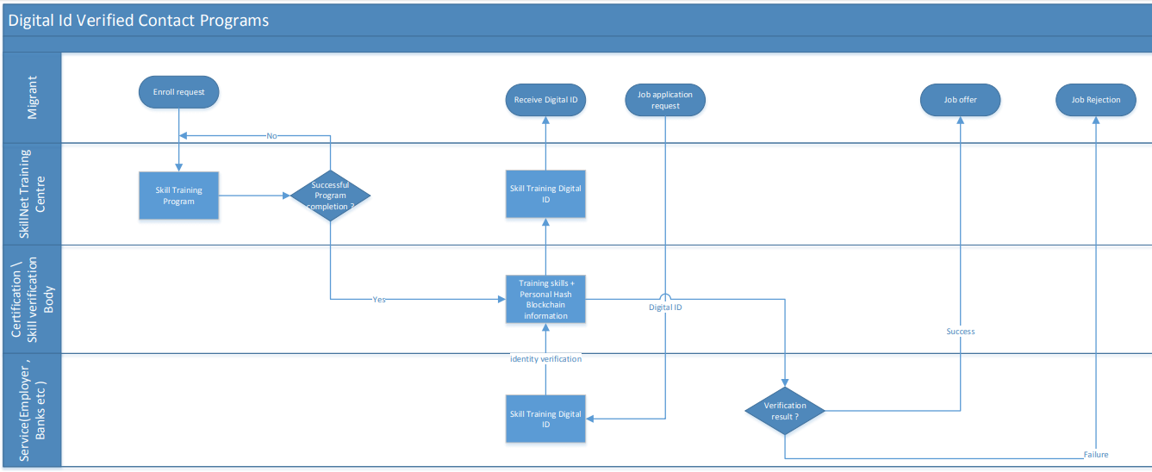
DIFA Cross Functional Flow Diagram

Slide 4
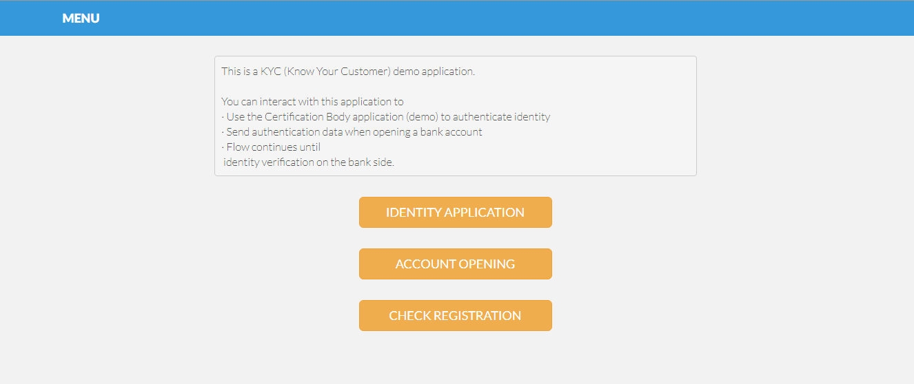

Slide 5
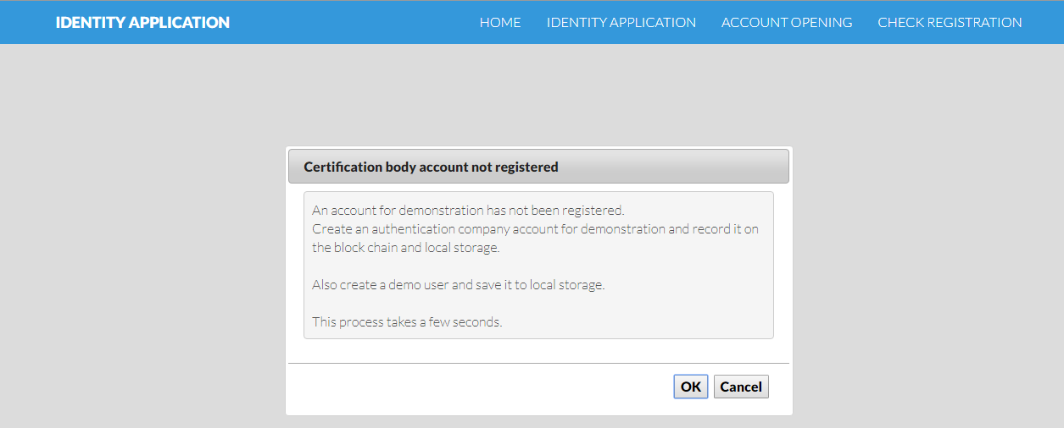

Slide 6
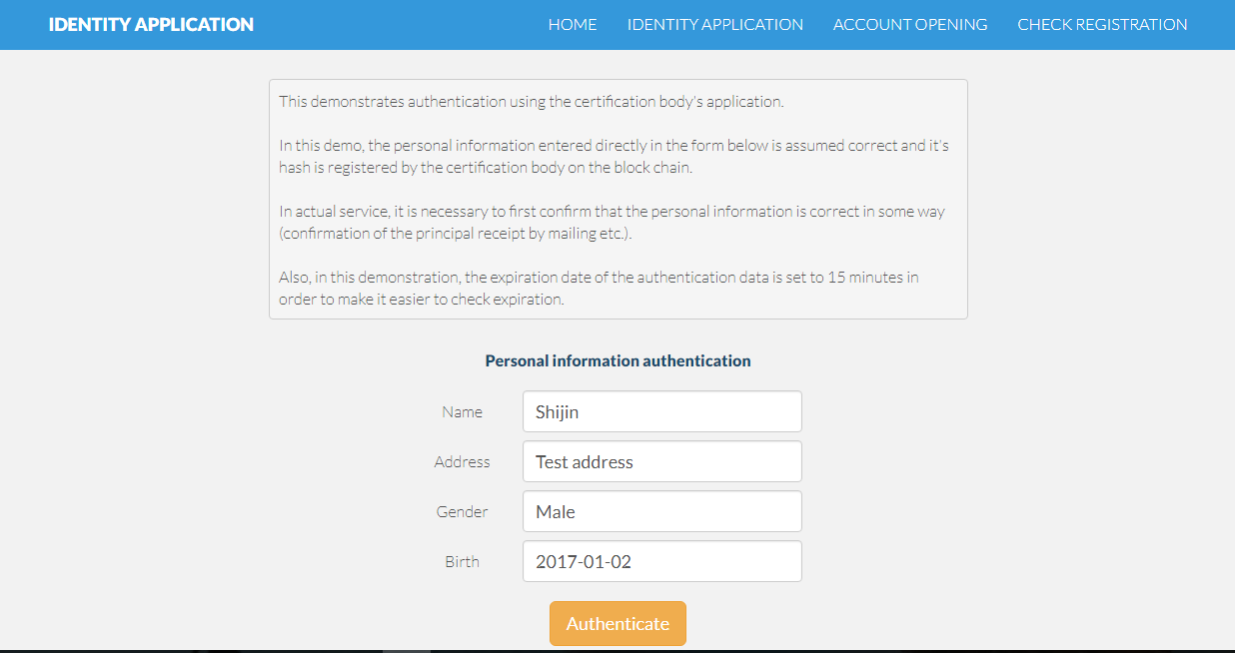

Slide 7
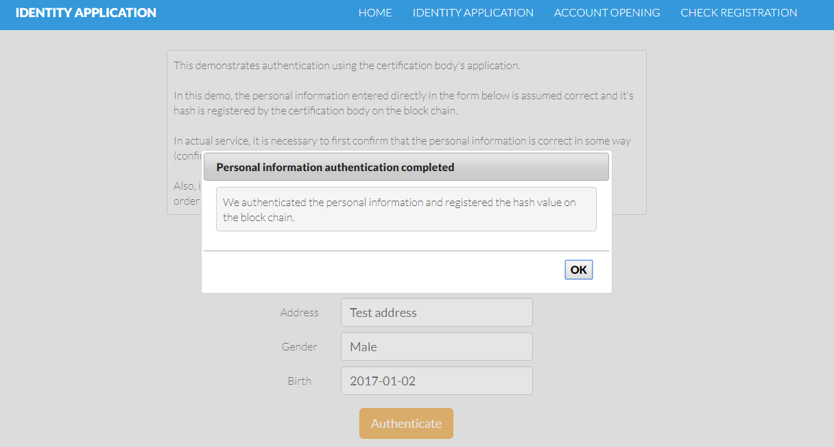

Slide 8
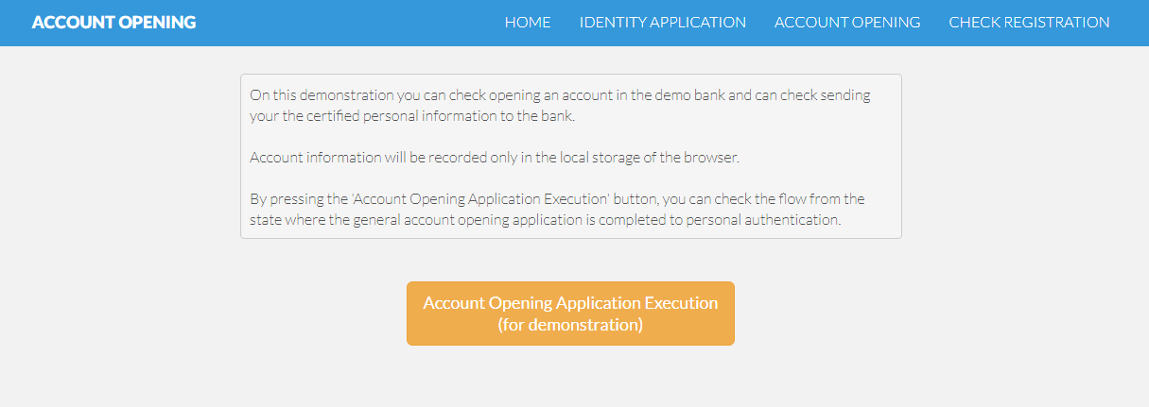

Slide 9
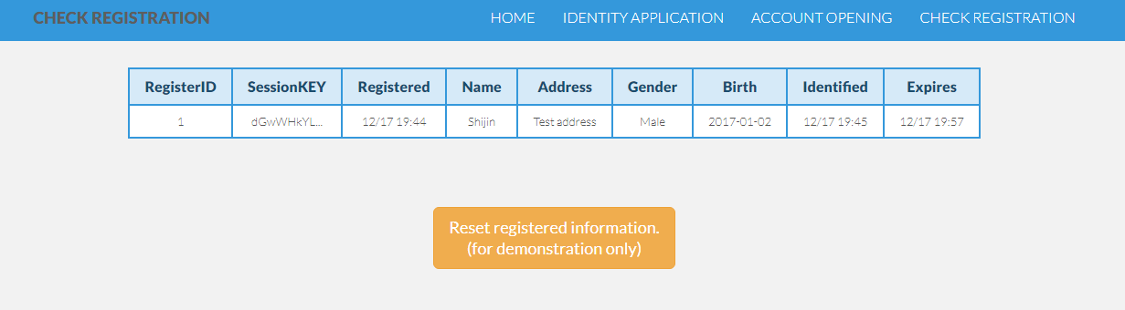

Slide 10
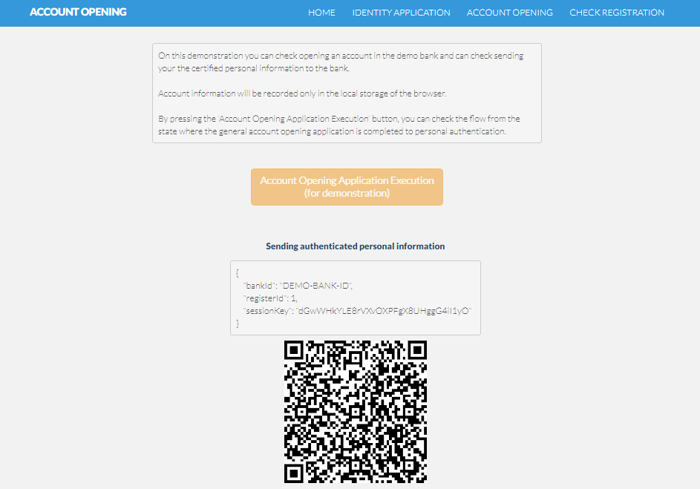

Slide 11
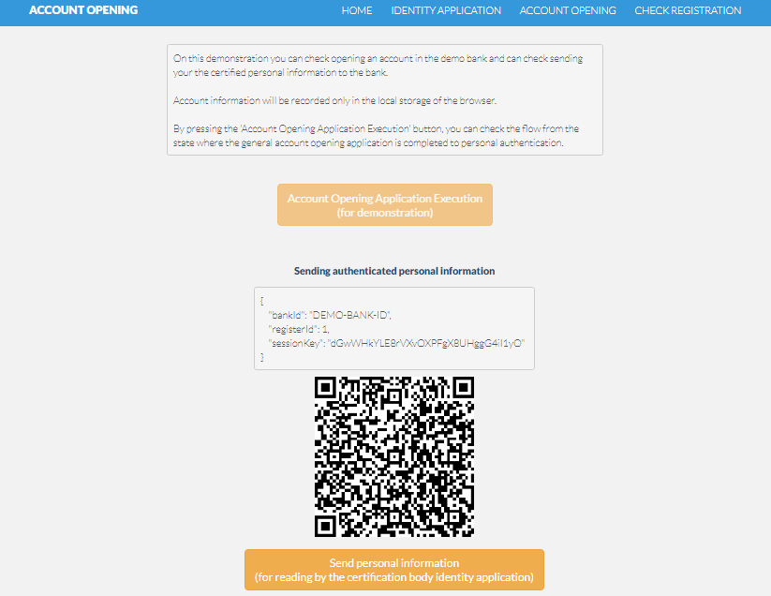

Slide 12
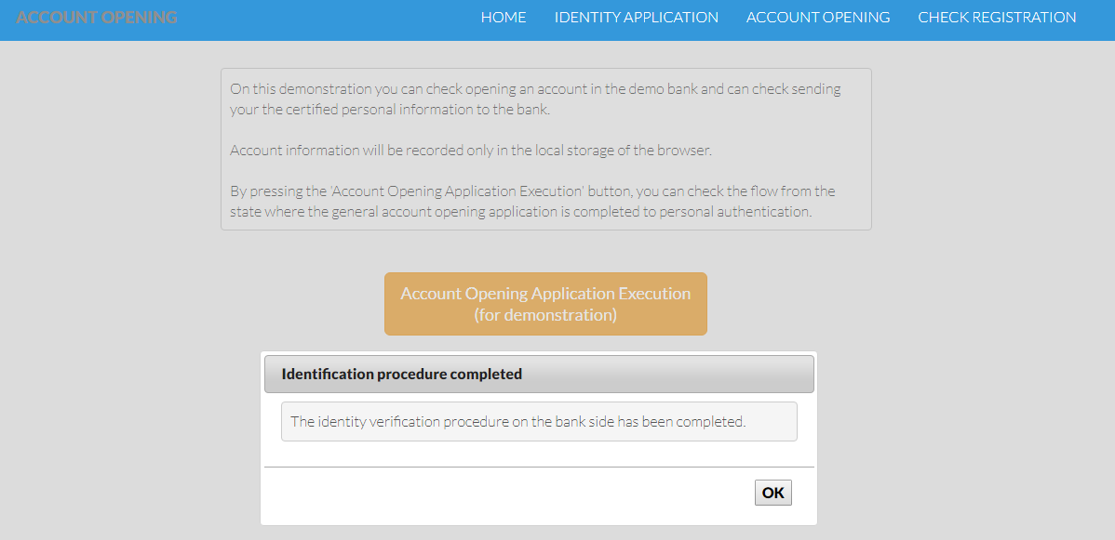

Slide 13
Thanks

